Slide 1
Google Slides Directions
Make a copy of the these slides and rename it.
(FILE - MAKE A COPY - RENAME - SHARE WITH TEAM MEMBERS: Can edit)
2. Keep TITLES on each slide (Except for HOOK) and delete text and red direction text and black example text on each slide to type in your own information for your team’s invention.
3. Divide and Conquer: It is helpful for each team member to be responsible for typing in information on his or her assigned slides.
4. Free Photos, Graphics and Music: It is important to not violate copyright laws when creating your presentation. Use CreativeCommons website to access free media: https://creativecommons.org/

Slide 2
Digital Tri-Board TEMPLATE
Invention Title
Add Team Names and Name of School

Slide 3
Hook
Hook Your Audience, get them interested! The examples you will see in this template are for the Skeeter Fan.
Tell a personal story:
I love being outdoors, but when my mom was pregnant, she worried about mosquito borne diseases such as Zika.
Ask a question:
Do you love being outdoors, but get frustrated every time you hear that high pitched whine, knowing you are about to get bit by a mosquito?
Statement:
All around the World, almost 3000 people, mostly young children, die each day due to diseases from mosquito bites.

Slide 4
Describe the Problem
Describe the problem here . . .
Our problem is that mosquitos spread diseases to people. Some of these diseases include Zika, Malaria, and Yellow Fever. 1 million people die every year because of mosquito-borne diseases. Also in Africa alone 1 child dies every minute. Lastly, the chemicals in mosquito repellant can be very harmful to you.

Slide 5
Who does this problem affect?
Describe the specific user:
Skeeter Fan:
People who live in places where there are a lot of mosquitos such as tropical climates or Africa.
Strobe Light Alarm Clock:
People who go to work.Note - this is too broad, you would need to better define the problem/product to know who will be your most likely consumer. Since this alarm clock uses flashing light and loud music, it would be best for college students.
Easy Eraser
Students in K-12 classrooms

Slide 6
How does your product solve the problem?
Clearly explain how your product solves the problem.
The Skeeter Fan is a fan that cools you down on a hot summer day and repels mosquitoes and other bugs. If the mosquitoes can’t bite you, you can’t catch their diseases.
*Add picture of product

Slide 7
Detailed description of invention
Be very specific! You need to write this for an “alien”.
Should not be too wordy.
Example: The Skeeter Fan concept is a variety of wearable accessories that feature fans that emit mosquito repelling diffused essential oils. The fan not only cools you down, but will also repel mosquitos naturally using lemongrass, rosemary, or lavender, scents that mosquitoes hate. The Skeeter Fan has 2 spinning blades and is solar powered.

Slide 8



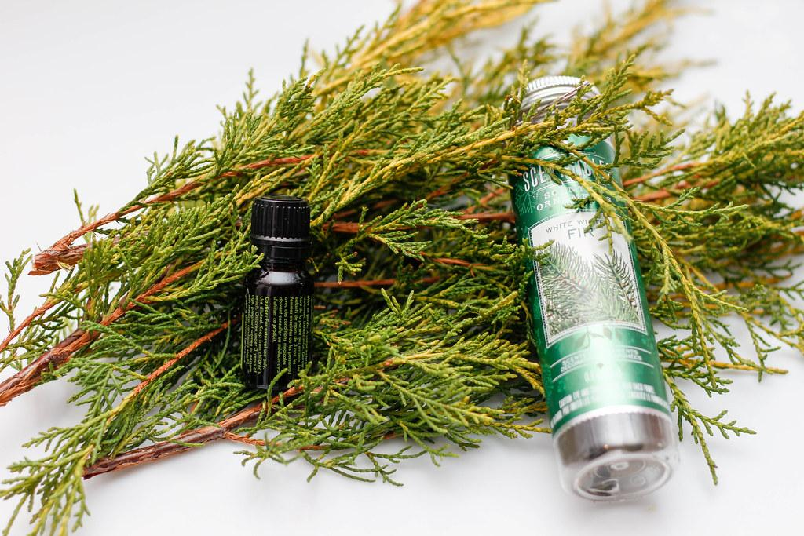

How does SCIENCE or TECHNOLOGY help explain how your product works?
Here are 5 powerful essential oils that naturally repel insects: http://info.achs.edu/blog/green-cleaning-repel-insects
1. Lavender Lavandula angustifolia (Mill.)
Along with its lovely floral aroma and soothing qualities, lavender is also effective at battling the bugs.
2. Basil Ocimum basilicum (L.)
One study showed O. basilicum exhibiting both mosquito repellent and larvicidal activity.[2]Basil is an uplifting oil, so add some to an atomizer and spray outside for a natural mosquito repellent and a well-deserved mood boost!
3. Thyme Thymus vulgaris (L.)
Thyme has been found to be a highly effective insecticide against houseflies.[4] A 2005 study also found thyme to be an excellent mosquito repellent as well.[5] Win, win!
4. Pine Pinus sylvestris (L.)
If you love camping but despise using Deet or other chemical bug sprays, pine is your perfect companion. A natural repellent against mosquitoes, pine will also keep you smelling fresh as the forest!
5. Vetiver Vetiveria zizanioides (Nash)
A natural mosquito deterrent in the house. Diffusing a few drops of this oil will help repel the mosquitoes and also create a spicy, Balinese ambience for summer.

Slide 9
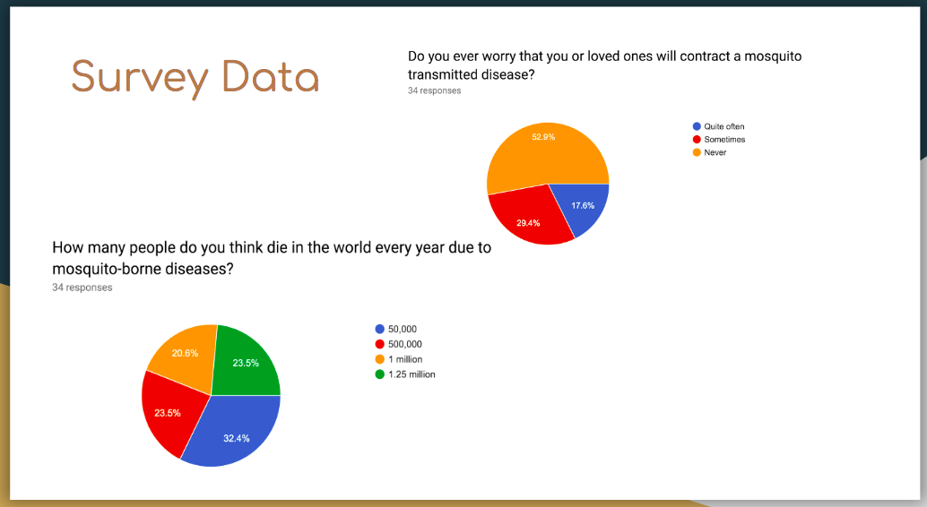
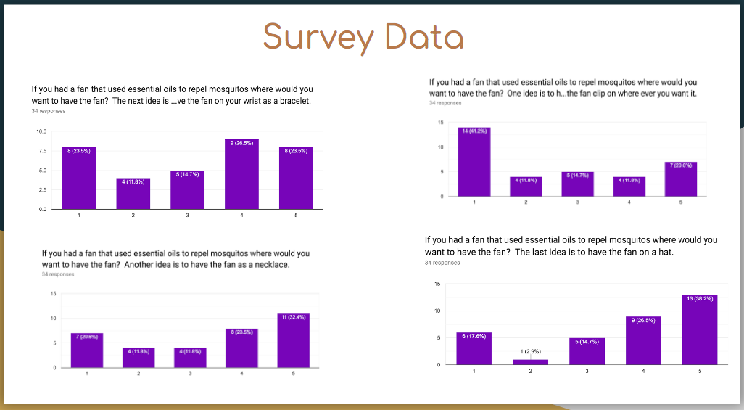
Survey Results
Insert graphs/charts here… include conclusions.

Slide 10
Interview Feedback
Clearly explain insights you gained with by interviewing people about your product. What did you conclude? What design decisions did you make based on these insights?
Example:
We conducted 10 interviews with potential users of the product and concluded the following:
Concerns about affordability
Interest in providing device to 3rd world countries
Are there any health concerns with using essential oils?

Slide 11
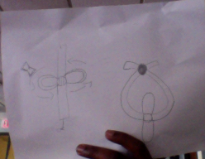
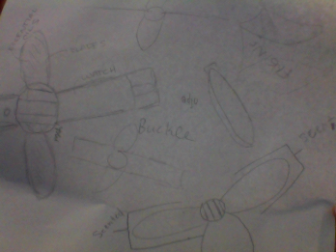
Sketches of Prototypes
In order to show your ITERATION process, you must have 2 to 4 sketches or photos of ideas you considered as your product developed.
Insert diagrams here
TinkerCAD: Copy and paste
Drawing: Scan and paste

Slide 12
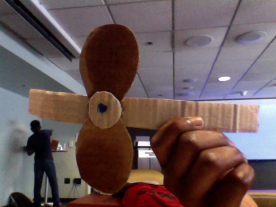
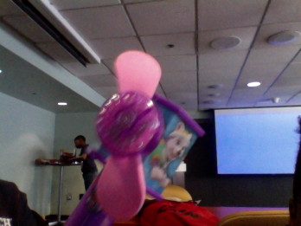
Photos of Prototypes
Insert photos of each prototype you created throughout the Inventure Process.

Slide 13
Prototype Materials
If you tested different materials when developing your prototypes, list them here. *Optional*
Material | Pros | Cons
Acetate | Low moisture absorbency, soft, mildew resistant, transparent | Sticks to body and sensitive to heat
Cellophane | Blocks odors and transparent | Tears easily

Slide 14
Final Prototype Materials
Outline materials that help improve your product. Don’t put anything too obvious here (ex: cardboard, tape).
Material | Why used (if applicable) | Cost
Acetate | Less likely to tear | $9.99 for 10 sheets

Slide 15
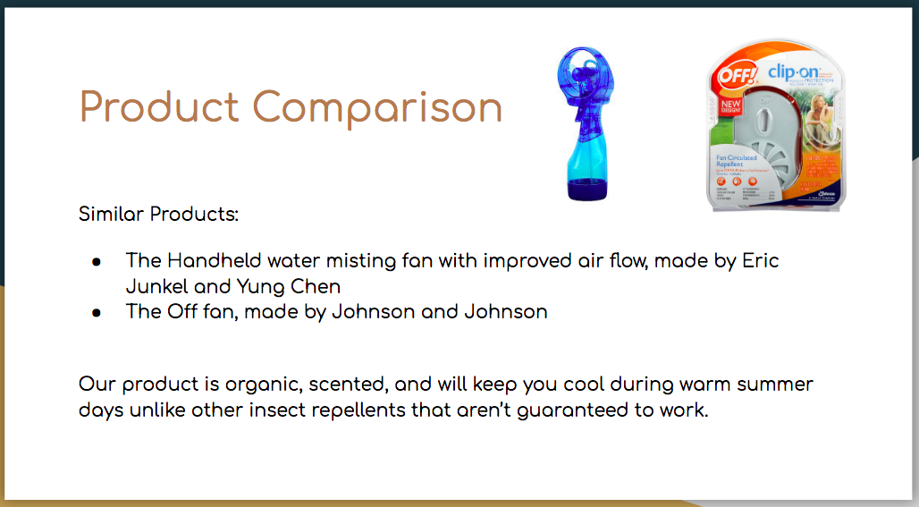
Product Comparison
Insert similar patents you found on Google Patents or similar products on Amazon, Walmart or other store. This is important as it VALIDATES your idea for originality.
How is your product different or better?

Slide 16
Marketing/Manufacturing
Who are you marketing your product to?
How much do you estimate it will cost?
What companies would you be interested in partnering with? Can they help you bring this product to market? Can they integrate your product into an existing product? ex: working with Pampers for the Diaper Window.
Are there any non-profit partnerships where you can “Give Back” - ex: Toms donates a pair of shoes for every pair purchased, African Malaria Association for mosquito repellant.

Slide 17
Consequence of Inaction
Describe what would happen if no one addresses this problem:
Examples:
Skeeter Fan
People will be bitten by mosquitos more often making them more vulnerable to diseases carried by these insects
Strobe Light Alarm Clock:
People will oversleep
Easy Eraser
People will throw away good pencils because of the eraser causing waste

Slide 18
Call to Action
Closing thoughts….what do you want to leave your audience with?
Example:
Will you protect the infant babies, pregnant women, and help prevent the spread of diseases each day? The choice, is yours.

Slide 19
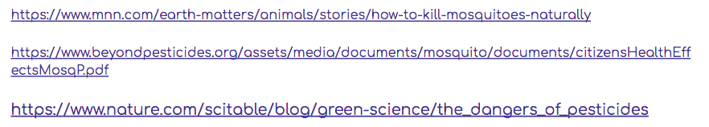
Sources & Citations
Add attribution and source citations here….
Example:

